Slide 1
Energy Security and State Capture Risks in CEE Region:
Between Geopolitics and Reality
March 19, 2015
Todor Galev

Slide 2
Energy Security in Europe

Slide 3
Fundamentals of Long-term Energy Security
Reducing import dependence
Increasing the number of suppliers
Utilization of indigenous resources and renewable energy resources
Reducing overall energy demand by introducing energy-efficient technologies

Slide 4
Quantifying Energy Security:
International Energy Security Risk Index
Developed by Institute for 21st Century Energy, U.S. Chamber of Commerce
International Energy Security Risk Index:
  Global fuel reserves
  Fossil fuel imports
  National energy expenditure
  Price and market volatility
  Energy use intensity
  Reliability of electricity generation
  Energy efficiency of the transport sector
  Environmental policies

Slide 5
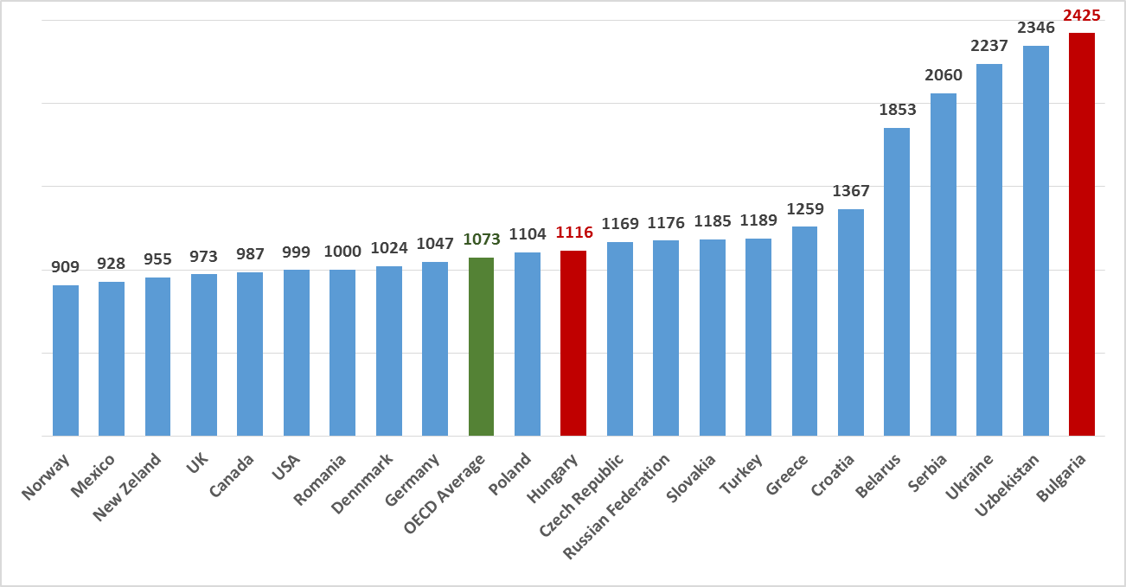
2013 International Energy Security Risk Index
Source: Institute for 21st Century Energy

Slide 6
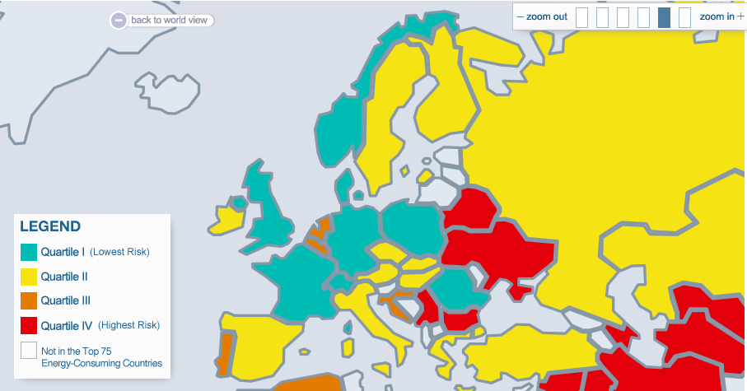
2013 International Energy Security Risk Index (2)
Source: Institute for 21st Century Energy

Slide 7
Bad Governance and State Capture
in the Energy Sector:
Russian-Bulgarian projects as case studies

Slide 8
Energy Security Challenges for Bulgaria
Main energy security challenges
  Energy expenditure intensity
  Fossil fuels import as percentage of GDP
  Oil & Gas import dependence
  Energy intensity
Main energy security risks:
  High energy poverty
  Low energy efficiency
  Governance deficits (political bottleneck in tackling risks)

Slide 9
Governance Deficits and State Capture in the Energy Sector
NPP Belene and South Stream projects:
  Lack of independent cost-benefit analyses
  Increasing economic and financial risks beyond the administrative and financial capacity of the SOE, national regulators, and the executives
  Lack of transparency (and fragile democratic state)
  Non-compliance with EU legislation and disregard for the free market and competition rules
  Bad governance of SOE and abuse of public funds

Slide 10
Russian Economic and Political Influence
  Increased involvement in the energy sector (investment's in existing companies, loans for ongoing and new infrastructure projects)
    Engaging the countries and their state-owned energy companies in large, inflated deals, which largely outweigh the capacity of the host industry to handle them properly, leaving national monopolies exposed to increased risk of financial dependence and subsequent loss of control over assets.
  Past collaborations in energy infrastructure, long-term supply contracts and ongoing technology transfer

Slide 11
Russian Economic and Political Influence (2)
  State capture mechanisms:
    Formation of domestic political elites /support to political parties
    Direct intervention of Russian companies’ officials for determing the legislative changes in national energy laws
    Lobbying “behind the scene” and suspicions for top-level political corruption
    Media campaigns in favor of Russian energy interests, paid by companies, legally not related, but having “common history” with subsidiaries of Russian companies in the country
    Increased links between Bulgarian and Russian oligarchs and companies, related to them, incl. for the implementation of large infrastructure projects in the energy sector
    Increased activity of Russian banks / private funds in major economic sectors (telecommunications, energy, construction, tourism)

Slide 12
Results: Financial / Political Dependence
Comparative Prices for Gas Pipelines with similar to the South Stream capacities
Project | Country/Project | Diameter | Cost (EUR mln./km)
South Stream | Russia, South Stream | 1420 | 7.4
OPAL | Germany, Nord Stream | 1420 | 2.1
NEL | Germany, Nord Stream | 1420 | 2.3
Gazelle | Czech Republic, Nord Stream | 1420 | 2.4

Slide 13
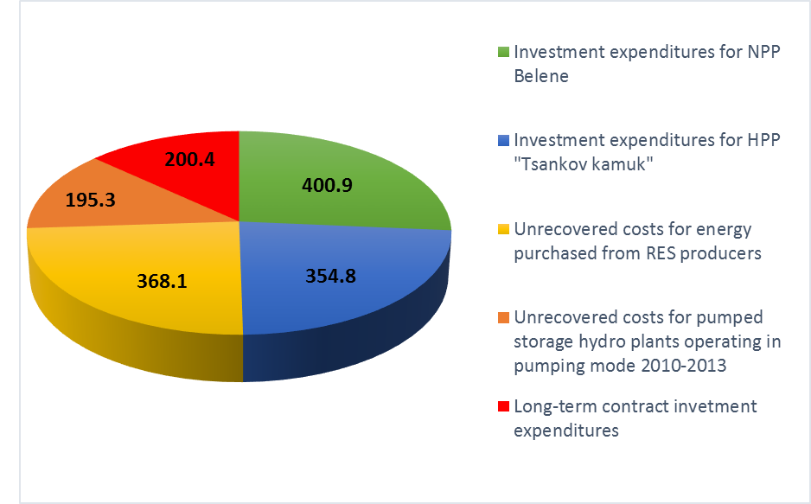
Results: Financial / Political Dependence (2)
Structure of accumulated debt by NEC for the period of 2010 – 2014 (EUR mln.)

Slide 14
Political Risks for CEE
The negative influence of the traditional energy security risks in CEE region is amplified by bad governance and state capture in the sector, which impedes the formation of a common and coherent regional energy strategy.
Energy SOE have been engaged in large, inflated deals, which largely outweigh the administrative and financial capacity of the national industries, leaving both the enterprises and the country exposed to increased risk of financial and political dependence.
The energy dependence of most of the countries in the CEE region has been used by Russia as a political tool to influence the governments’ decision-making.
The lack of comprehensive and in-depth monitoring of the energy policy development because of its innate technical complexity and notorious lack of transparency has undermined the ability of the civil society sector to have an effective impact on decision-making in general, and as concerns anti-corruption and good governance, in particular.

Slide 15
Political Risks for CEE (2)
State capture mechanisms undermine additionally the fragile democracies in some of the CEE countries
“Price of dependence” is paid by end customers through higher cost of energy resources
Create favorable environment for corruption, strengthening the links between organized crime groups, policy makers and economic oligarchs
Hamper energy internal market integration, liberalization and diversification and thus, decrease the energy security of the countries
The prevalence of state capture mechanisms often leads the governments to suboptimal decisions that side-line their own planning and investment needs
Weak public procurement legislation and law enforcement
Continuation of bilateral instead of multilateral or regional approach to energy security policy

Slide 16
Recommendations
Independent annual review of the national energy security risks and targets
Creation of an effective legal and regulatory framework for SOEs
Introduction of compulsory corporate governance standards for state-owned companies
Development of indigenous energy resources and diversification of gas supply
Development of regional gas and power markets
Improvement of energy efficiency
Prioritization of large investments projects, synchronized with the EU priorities and preliminary cost-benefit analysis and compulsory feasibility assessment

Slide 17
Thank you!
www.csd.bg
todor.galev@online.bg

Slide 18
Governance Deficits and State Capture: the case of NPP Belene
NPP Belene project initiated in the 1970s;
Questionable economic feasibility from the very beginning, incl. expressed by state authorities and official project financial consultants.
Project’s cost forecasts have not been updated until 2012
Project’s price, thus the price of electricity produced, have became a subject of enormous political controversy:
  Only overnight costs were made public until recently - EUR 4 bln.
  Additional expenses (incl. for grid access, project administration, etc.) and escalations (inflation-adjusted costs) have been estimated to EUR 6-7 bln.
  Total cost estimation by CSD in 2011, confirmed later by HSBC analysis: over EUR 10 bln.

Slide 19
Governance Deficits and State Capture: the case of NPP Belene (2)
Huge potential for posing serious threat to the financial security of the country:
  Sizeable investment (incl. substantial upfront costs) that is extremely sensitive to the duration of the construction phase: the costs of an NPP project increase with every additional year of construction (contract costs with Atomstroyexport increased with more than EUR 2 billion in two years - 2008 – 2010)
  ROI timeframe is long (30-40 years) and hard to be estimated in the increasingly liberalized European market
  Management issues (most notably, disposal) of high-level radioactive waste remain unresolved, and could be extremely expensive
  Atomstroyexport (Rossatom) filed a lawsuit against Bulgaria for the cancellation of the NPP Belene project, claiming for EUR 1 bln. :
    The governments and high-level politicians were controversial on the case, incl. then-PM Mr. Oresharski said in June 2013 that Bulgaria is likely to lose the case

